Slide 1

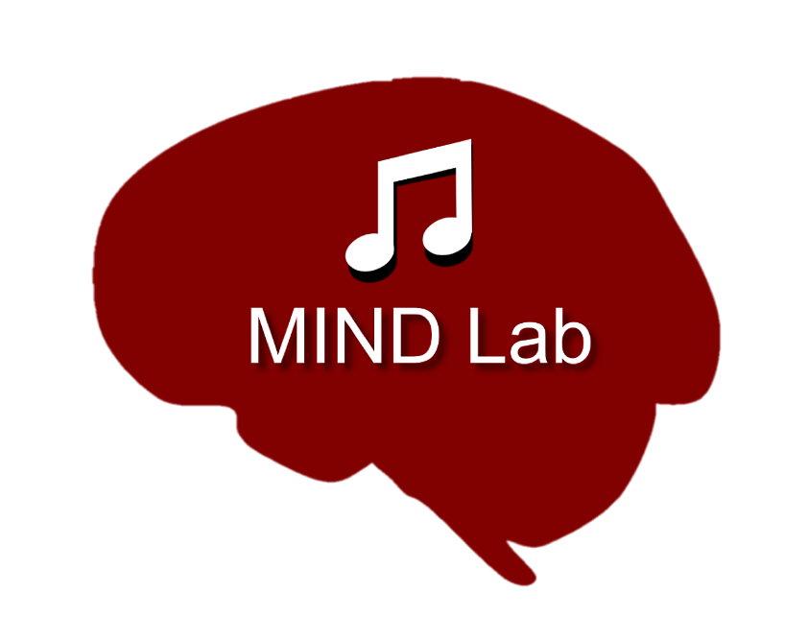

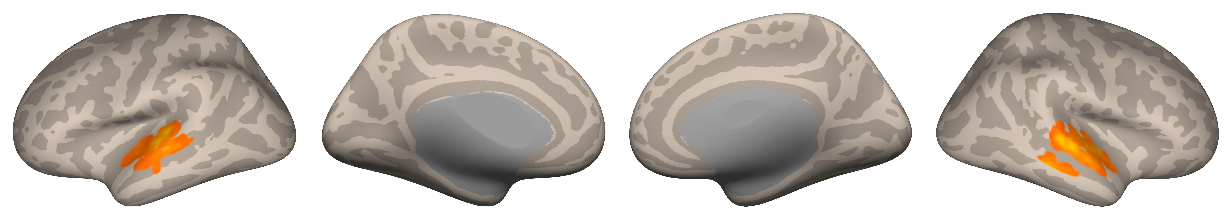
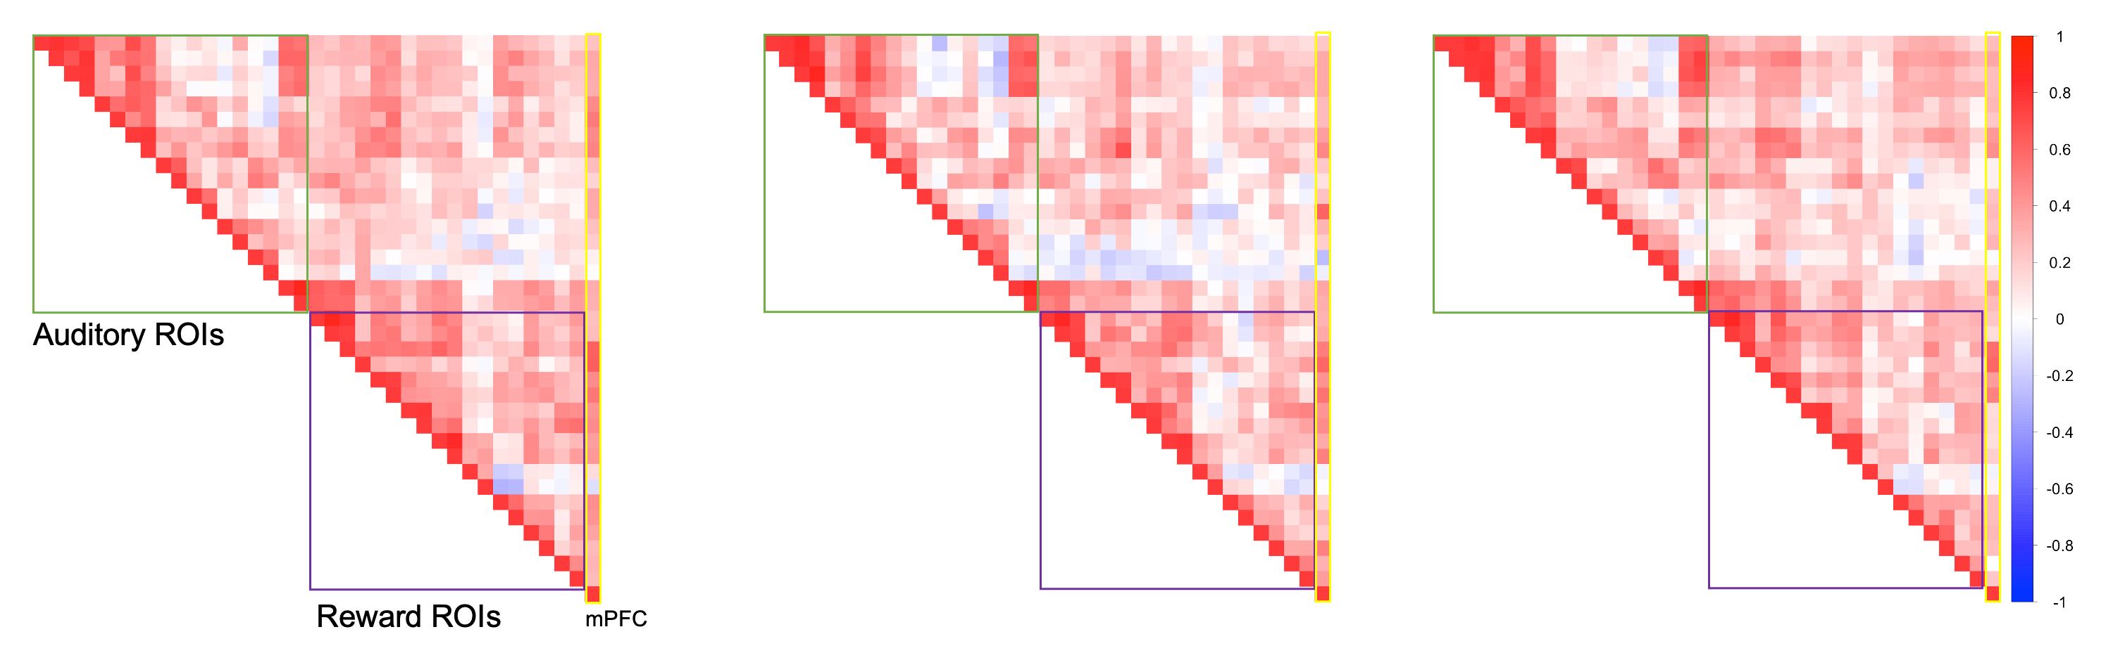
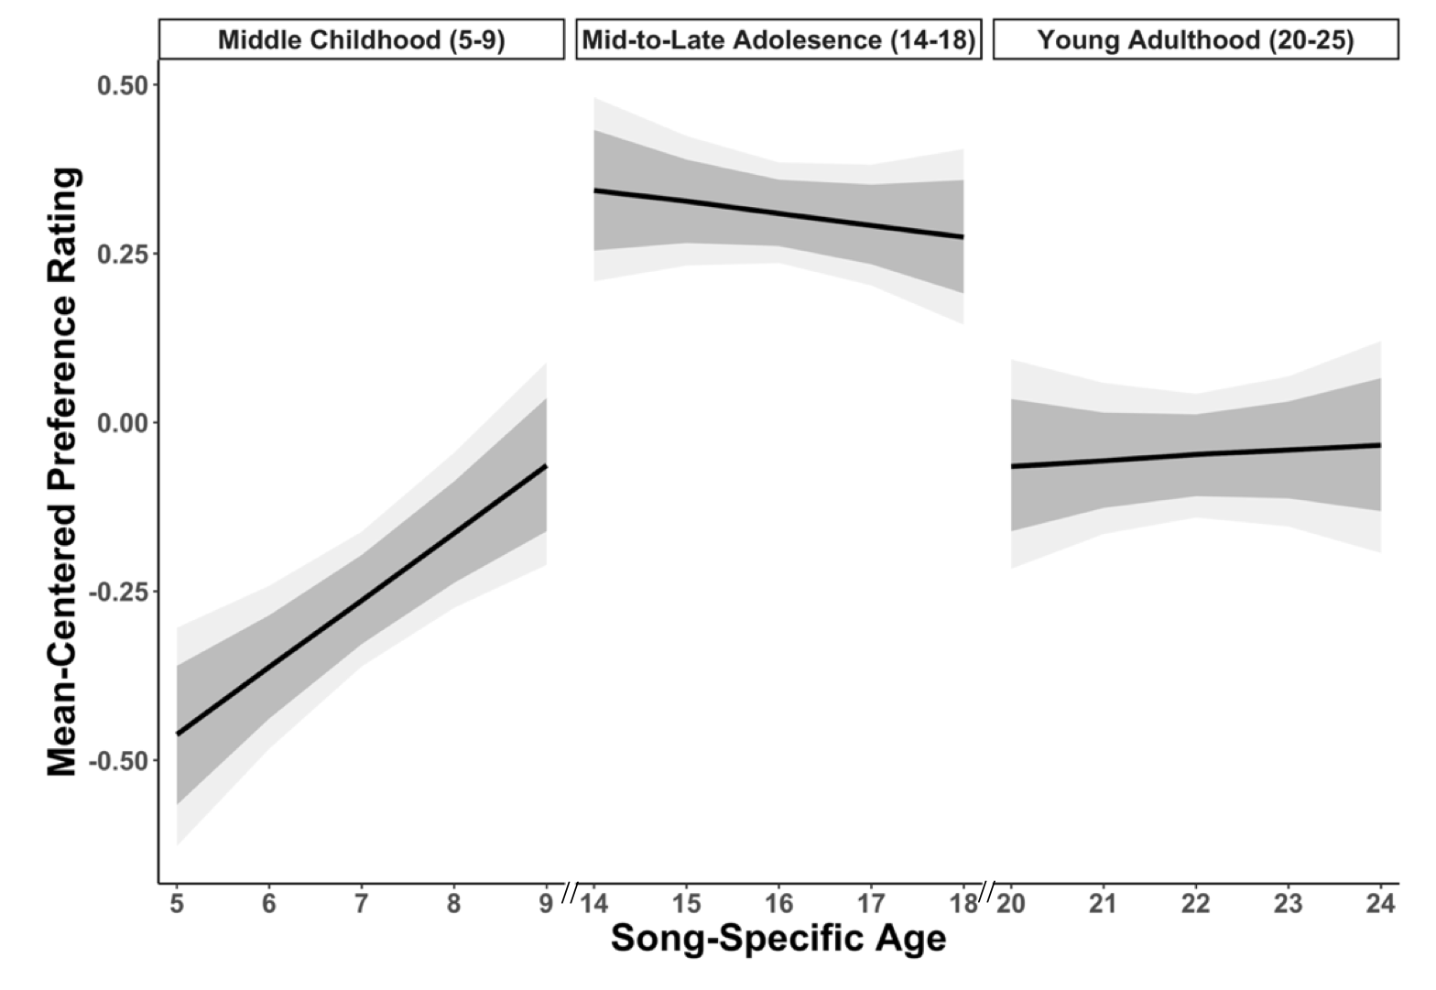
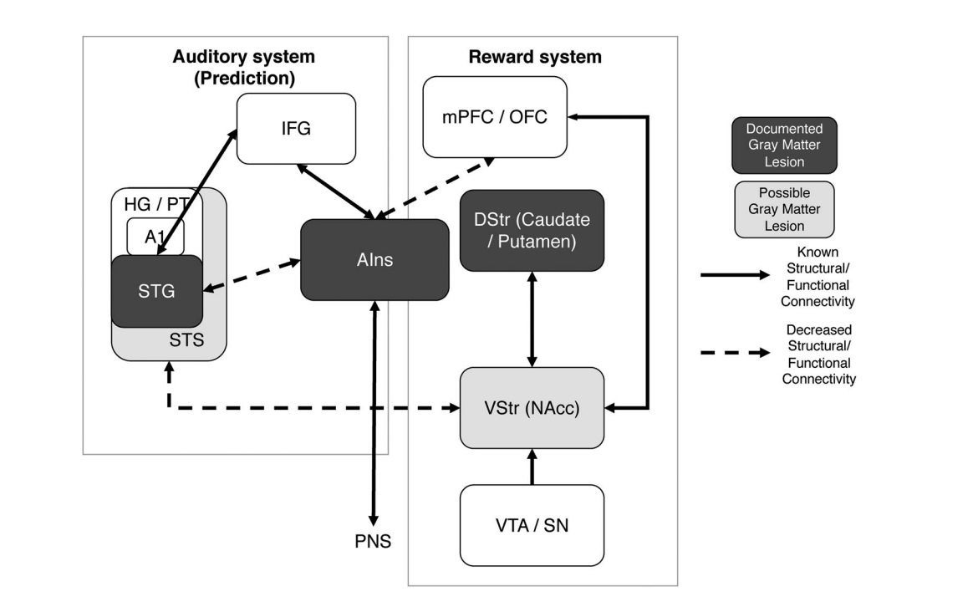
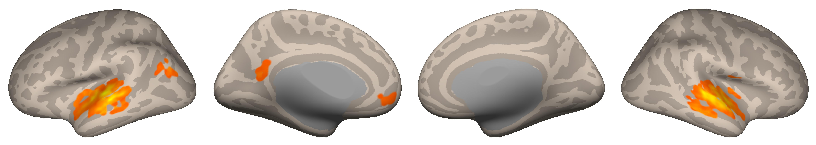
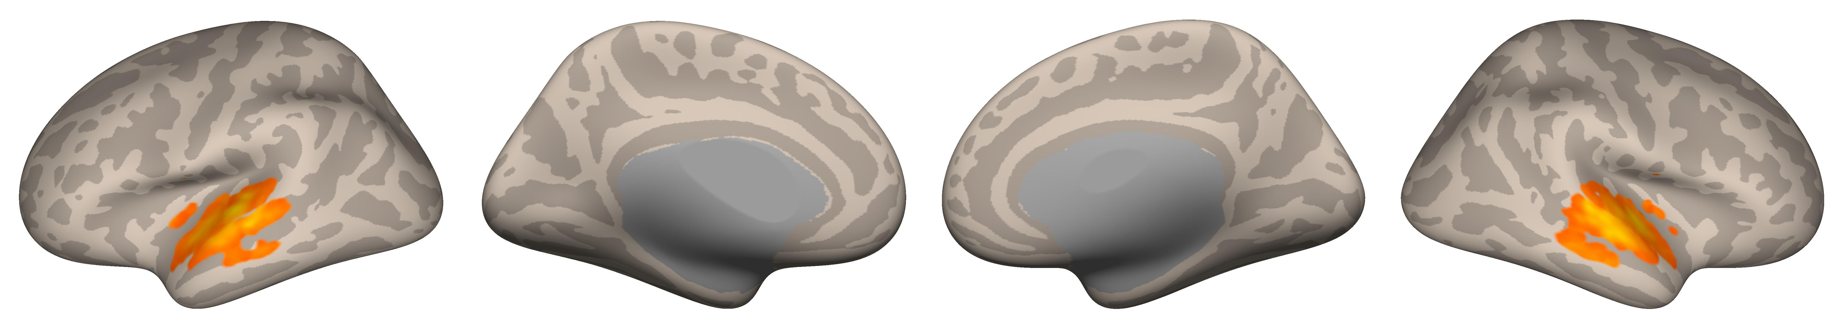
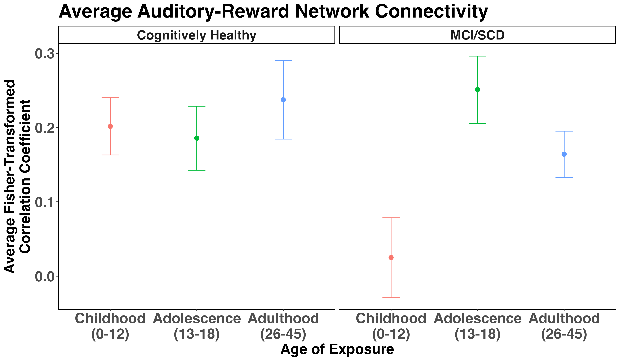
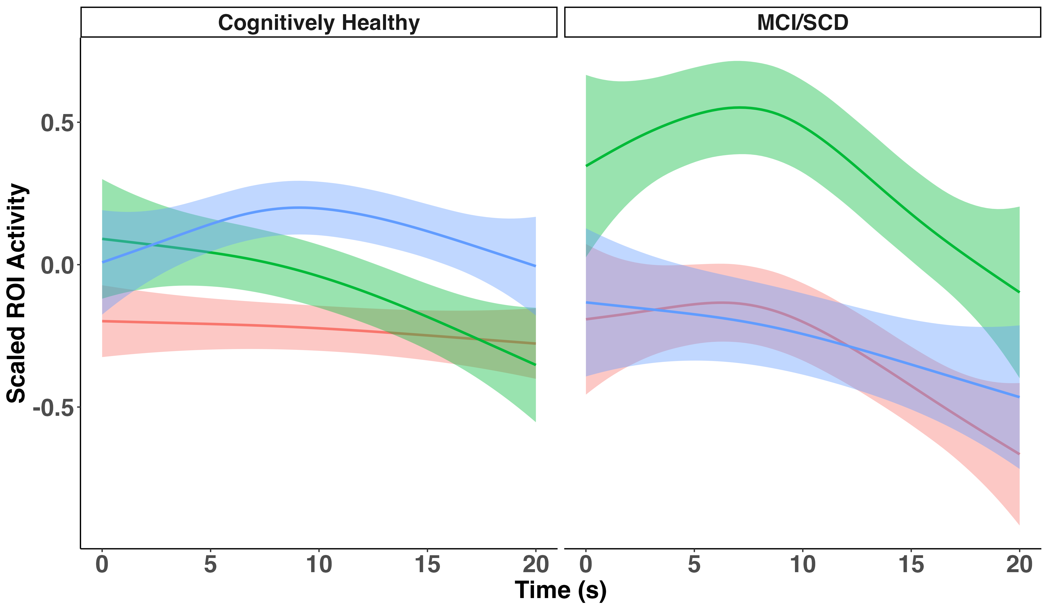
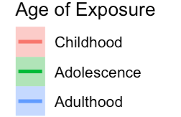
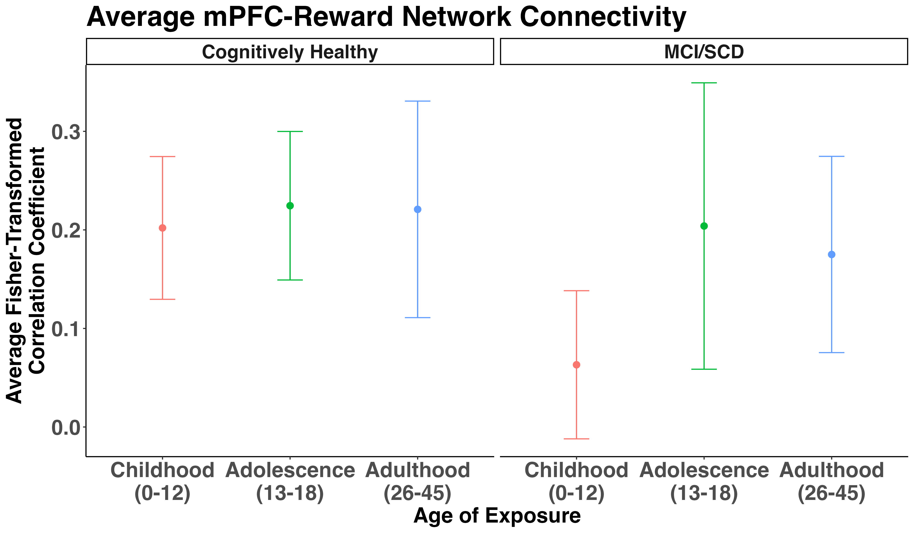
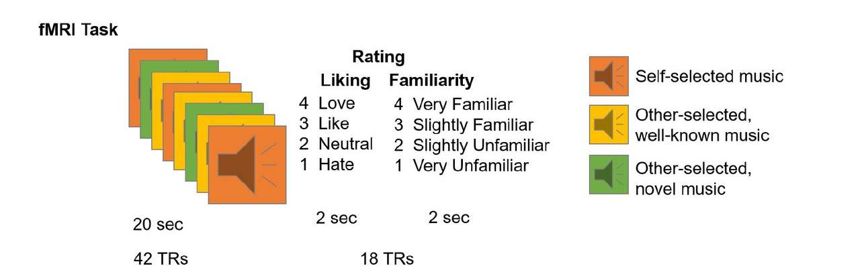
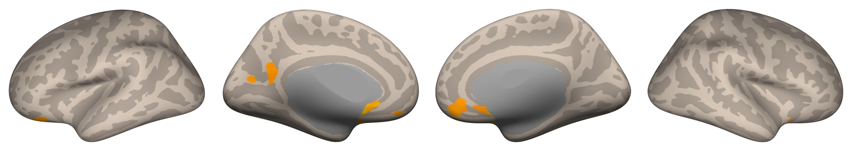

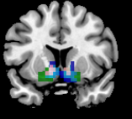
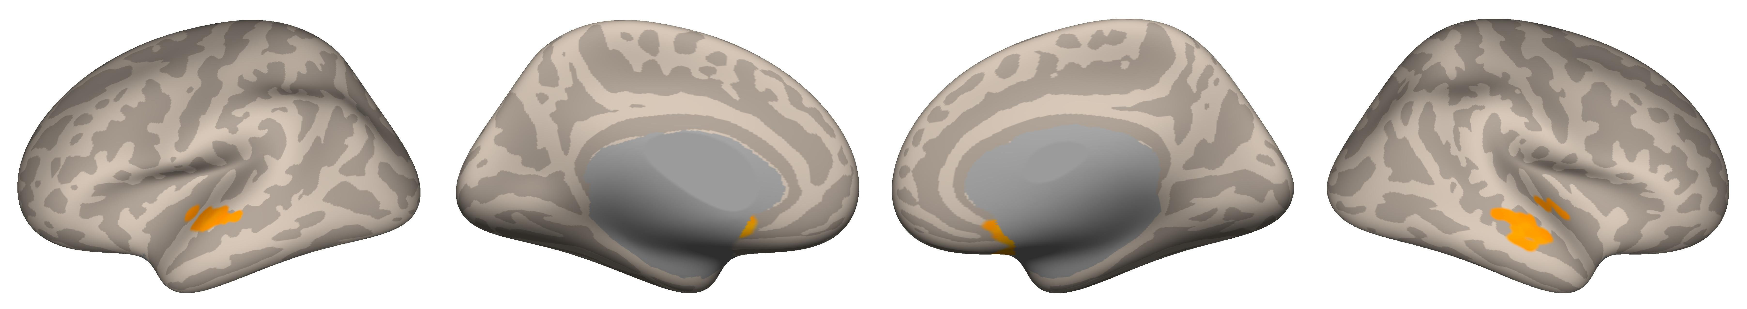
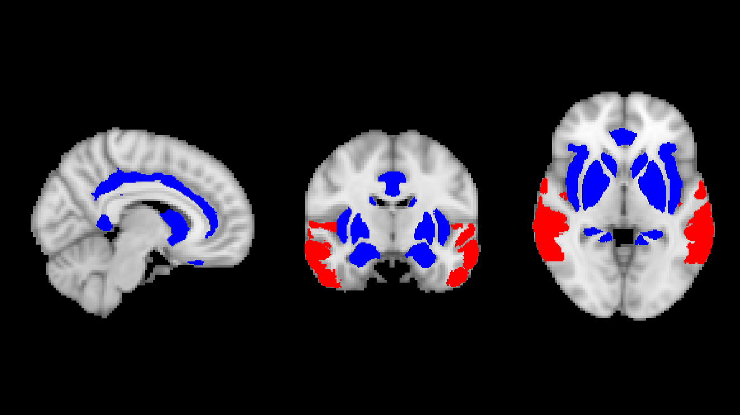

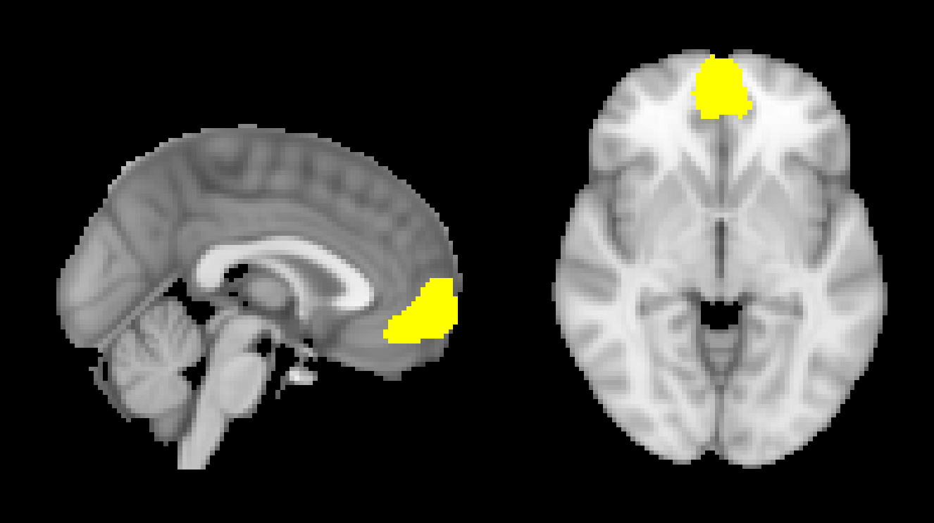


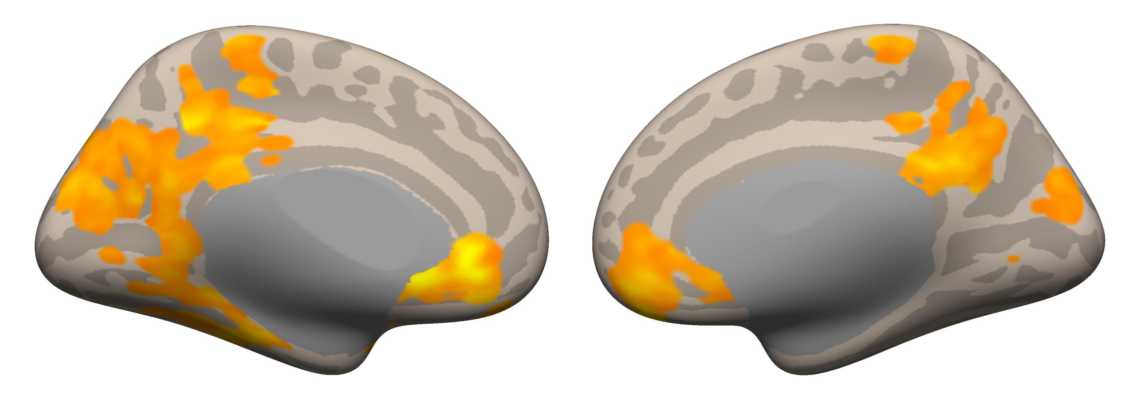




Age-Specific Effects of Music Encoding on Reward and
Memory Systems in Healthy and Cognitively Impaired Aging
Nicholas Kathios, Laurel Gabard-Durnam, Psyche Loui
Northeastern University, Boston, MA
Background
Univariate Main Effect of Age of Exposure
ROI-ROI Connectivity
Older adults recall the most autobiographical memories from when they were between the ages of 10-30 years (the “reminiscence bump” effect)¹. Music-evoked autobiographical memories are most common in response to music from this time period in cognitively healthy² and impaired populations³. Older adults also show lifelong preferences for this music⁴, suggesting music from adolescence and young adulthood may be most effective at engaging reward and memory systems in aging populations.
Pleasurable music listening experiences involve interactions between the auditory and reward systems⁵. Adolescents show heightened sensitivity to reward cues due to the functional development of the reward system⁶. Thus, listeners’ lifelong preferences for adolescent music might be a result of heightened reward responses to music during this time⁷ and autobiographical associations listeners have with this music⁸.
Hypothesis: Music first encoded during adolescence will optimally engage the activity and connectivity of memory and reward systems compared to other developmental time-points, resulting in a neural “reminiscence bump” effect.
Childhood (0-12)
Childhood (0-12)
Adolescence (13-18)
Adulthood (21-45)
Adolescence (13-18)
Adulthood (21-45)
Voxel Threshold: p uncorrected <0.001;
Cluster Threshold: p FDR-corrected <0.05; positive contrast
Right NAcc Activation Time Series
Methods
Thirty older adults (ages 50-85; M=65) who were either cognitively healthy (n=22) or cognitively impaired (mild cognitive impairment [MCI] or subjective cognitive decline [SCD], n=8) completed a music-listening fMRI task.
Clips were categorized based on timing of exposure: childhood (0-12), adolescence (13-18) or adulthood (21-45) using a combination of self-reports & Song-Specific Age (SSA).
MRI data were acquired using a Siemens Magnetom 3T MR. Continuous acquisition was used for 1440 volumes with a fast TR of 475 ms. Forty-eight axial slices were acquired as echo-planar imaging (EPI) functional volumes covering the whole brain (voxel size = 3 mm³). Data were preprocessed and analyzed using SPM12 (Statistical Parametric Mapping) software⁹ and the CONN Toolbox¹⁰. For seed to whole brain functional connectivity analyses, we seeded the nucleus accumbens¹¹. For ROI-ROI connectivity analyses, we seeded the Reward and Auditory Networks¹¹ along with the mPFC as defined by the CONN Toolbox.
NAcc Seed-Based Connectivity
Adolescence (13-18)
Data Acquisition & Regions of Interest
Discussion
Adulthood (21-45)
Adolescence
Our results provide neuroscientific evidence that parallels the “reminiscence bump” effect in older adults. Adolescent music elicited greater fronto-striatal connectivity in the cognitively healthy group; these differences generalized towards reward system connectivity with the auditory system and mPFC in those with MCI/SCD. Music experienced during adolescence may be particularly emotionally salient, leading to both increased lifelong consolidation of associated memories and heightened coactivation of memory and reward systems. This offers insight as to why music-evoked memories may be protected against neurodegeneration and highlights the utility of music from early development in both clinical and everyday settings.
Rubin, D. C., & Schulkind, M. D. (1997). The distribution of autobiographical memories across the lifespan. Memory & Cognition, 25(6), 859–866. https://doi.org/10.3758/BF03211330
Jakubowski, K., Eerola, T., Tillmann, B., Perrin, F., & Heine, L. (2020). A Cross-Sectional Study of Reminiscence Bumps for Music-Related Memories in Adulthood. Music & Science, 3, 2059204320965058. https://doi.org/10.1177/2059204320965058
Baird, A., Brancatisano, O., Gelding, R., & Thompson, W. F. (2018). Characterization of Music and Photograph Evoked Autobiographical Memories in People with Alzheimer’s Disease. Journal of Alzheimer’s Disease, 66(2), 693–706. https://doi.org/10.3233/JAD-180627
Krumhansl, C. L. (2017). Listening Niches across a Century of Popular Music. Frontiers in Psychology, 8, 431. https://doi.org/10.3389/fpsyg.2017.00431
Belfi, A. M., & Loui, P. (2020). Musical anhedonia and rewards of music listening: Current advances and a proposed model. Annals of the New York Academy of Sciences, 1464(1), 99–114. https://doi.org/10.1111/nyas.14241
Casey, B., Galván, A., & Somerville, L. H. (2016). Beyond simple models of adolescence to an integrated circuit-based account: A commentary. Developmental Cognitive Neuroscience, 17, 128–130. https://doi.org/10.1016/j.dcn.2015.12.006
Ferreri, L., & Rodriguez-Fornells, A. (2022). Memory modulations through musical pleasure. Annals of the New York Academy of Sciences. https://doi.org/10.1111/nyas.14867
Lamont, A., & Loveday, C. (2020). A New Framework for Understanding Memories and Preference for Music. Music & Science, 3, 2059204320948315. https://doi.org/10.1177/2059204320948315
Penny, W. D., Friston, K. J., Ashburner, J. T., Kiebel, S. J., & Nichols, T. E. (2011). Statistical Parametric Mapping: The Analysis of Functional Brain Images. Elsevier.
Whitfield-Gabrieli, S., & Nieto-Castanon, A. (2012). Conn: A Functional Connectivity Toolbox for Correlated and Anticorrelated Brain Networks. Brain Connectivity, 2(3), 125–141. https://doi.org/10.1089/brain.2012.0073
Wang, D., Belden, A., Hanser, S. B., Geddes, M. R., & Loui, P. (2020). Resting-State Connectivity of Auditory and Reward Systems in Alzheimer’s Disease and Mild Cognitive Impairment. Frontiers in Human Neuroscience, 14. https://www.frontiersin.org/article/10.3389/fnhum.2020.00280
We acknowledge support from NIH R21 AG075232, R01 AG078376, R43AG078012, and NSF-CAREER 1945436 to PL.
Childhood
Adulthood
Voxel Threshold: p FDR-corrected <0.05;
Cluster Threshold: p FDR-corrected <0.05
No cortical areas for music from childhood (0-12) survived corrections.
Adolescence > Childhood & Adulthood
Cognitively Healthy
References
Auditory (red) and
Reward (blue) Networks
Nucleus Accumbens (NAcc)
Medial Prefrontal Cortex (mPFC)
Voxel Threshold: p uncorrected <0.05;
Cluster Threshold: p FDR-corrected <0.05; positive contrast
This comparison for the MCI/SCD group did not survive corrections.
kathios.n@northeastern.edu
@nickkathios

